Slide 1
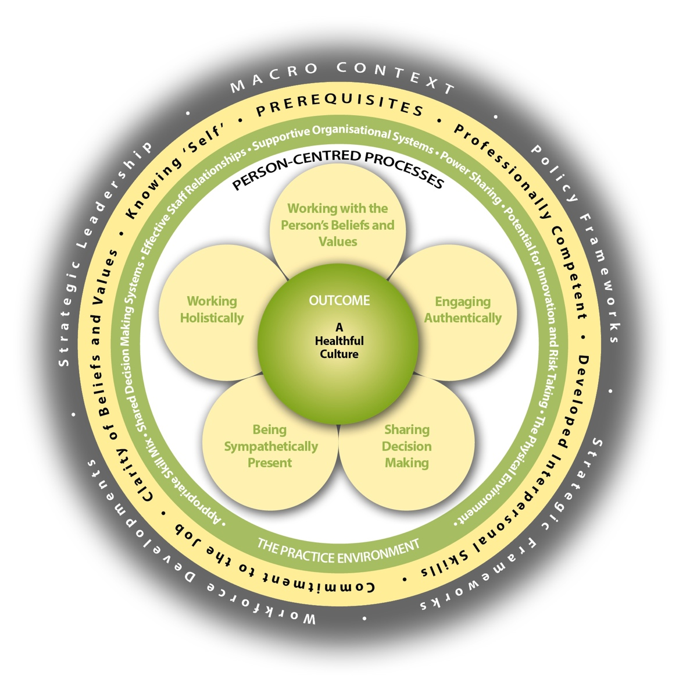
Person-Centred Practice Framework
McCormack & McCance (2021)

